Slide 1
Understanding Global Variables and Contexts
February 15, 2018
Presenter:

Slide 2
Understanding Global Variables and Contexts
Understand Global variables and their usage
Understand Context variables and define their value inside the Job.
Context groups
Define context variables in Repository, which can be made available to multiple jobs.
Populate the values of context variables from file. (tContextLoad)
Pass context variables or parameters from Parent Job to Child Job.
How to Pass the value of Context Parameters /Variables from command Line.

Slide 3
Understand Global variables and their usage
Global variables, in the Studio context, are variables that are available to all components,
modules, or functions within a job. As we develop jobs in the Studio, global variables are
made available depending upon the components used.
However, the Studio makes it easy for us to create our own global variables as well using
globalMap.put function.
For Example:
String datestamp=TalendDate.getDate("YYYYMMDD");
globalMap.put("dateStamp",datestamp);
To get the global variable value, use command:
(String)globalMap.get(“dateStamp"))

Slide 4
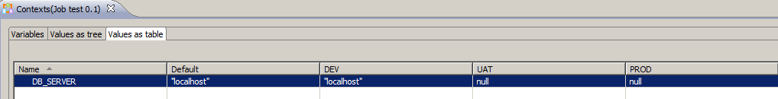
What are Context variables? Define their values inside the Job
Context variables allow jobs to be executed in different ways, with different parameters.
Contexts are user-defined variables that can be invoked at runtime.
These can be embedded in the job you are developing and are configured much like any
other component parameters in the window below the Job Designer.

Slide 5
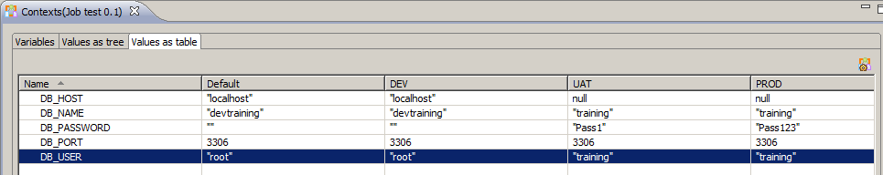
Context Groups
In Talend Open Studio you can create several context groups which hold various variables. Think of context groups as a bucket for related variables. For each context group you can define various contexts like production, development, test etc. This is extremely useful when moving your ETL jobs from one environment to the other.

Slide 6
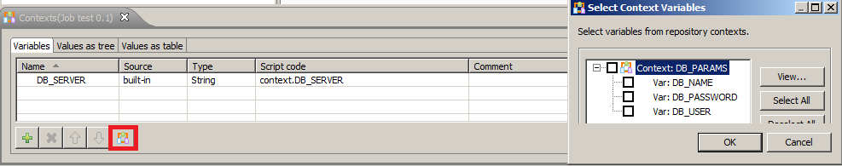
Define context variables in repository
Contexts can be stored in the Studio repository, allowing them to be centrally maintained, available to other developers and reused on other jobs.
If you plan to use a set of context variables in more than one job, it makes sense to add them to the repository, rather than embed them directly in the job.

Slide 7

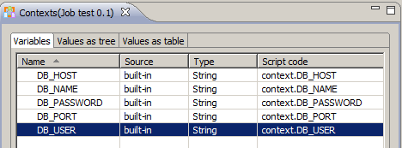
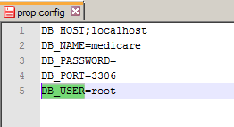
Populate the values of context variables from file
External context variables are variables held in a file and loaded into the Studio job at runtime.
Context Variables definitions in Job
Job loading parameter values to context
File containing values for parameters

Slide 8
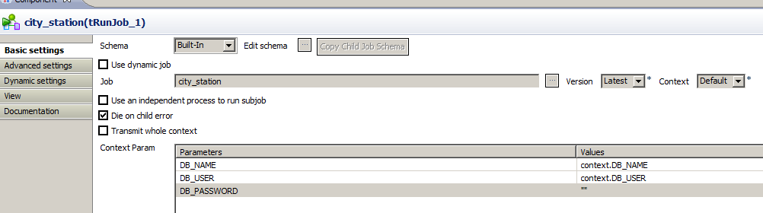
Pass context variables from Parent Job to Child Job
We can pass context variables’ values from main job to sub jobs two ways:
Partially : Pass each parameter in the “context param” part of Component window for the subjob

Slide 9
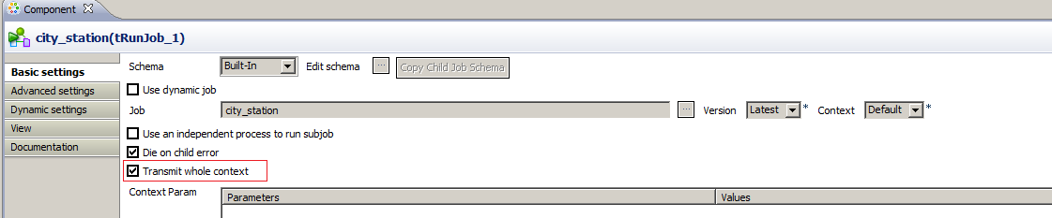
Pass context variables from Parent Job to Child Job
Fully : Full context is transferred from main job to sub job.

Slide 10
Pass the Context Parameters value from command Line
To provide context fully from command line append following to the exe call:
--context=prod (Name of the context groups)
Where prod is the filename which contains context variables.
To pass individual context variables from command line append following to the exe call :
--context_param DB_NAME=prodtraining
For example:
TALEND_JOB.bat --context_param CONFIG_FILE_PATH=talend.properties

Slide 11
Questions?
Copyright © 2014 by Vikram Takkar. All Rights Reserved..

